Slide 1
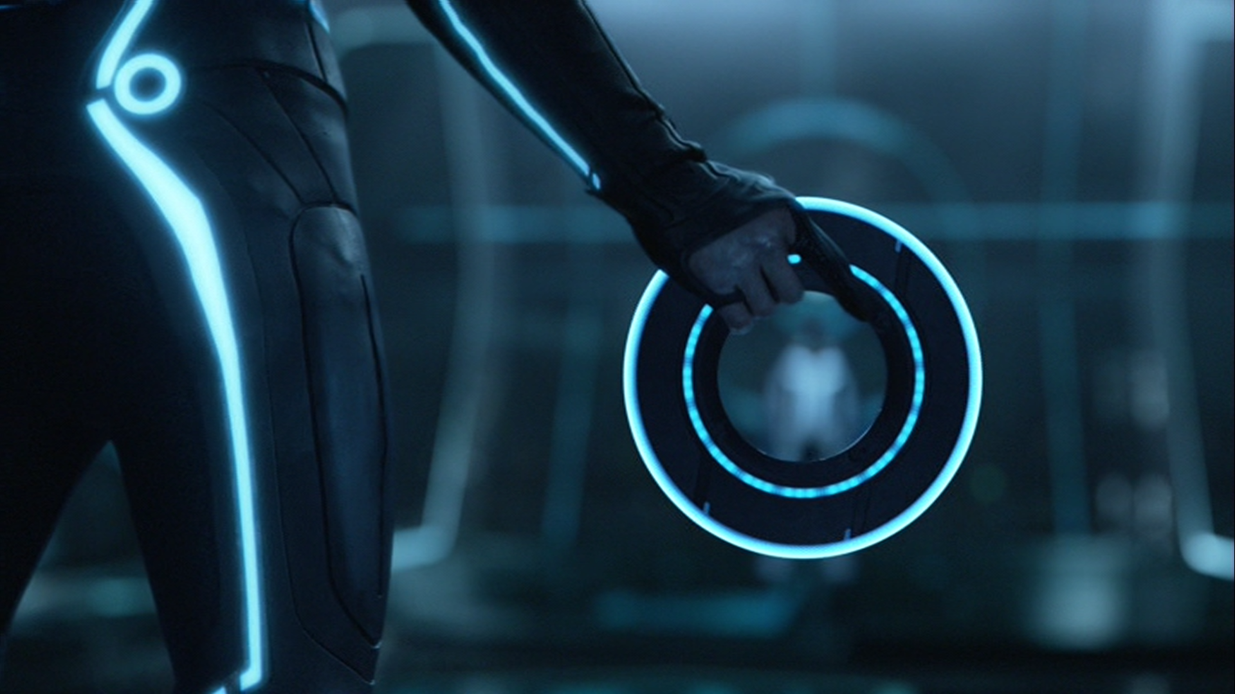
Frisbee Trajectory
Natiah Randrianasolo & Khalif Ortega Beckles
Notes:
A template for students to design a field trip to a location for other students to view. Includes directions to the student of what to include on each slide and what content should be considered.

Slide 2
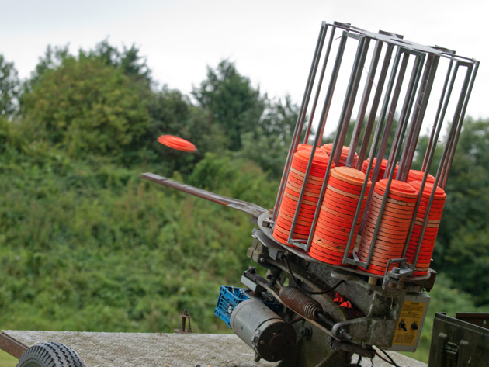
Question
“What is the optimal initial angle to throw the frisbee that will produce the furthest distance travelled?”

Slide 3

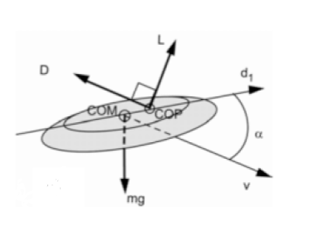



Description of the Model
Drag force
Lift force
Angle of attack
Angle of tilt
Angle of velocity

Slide 4


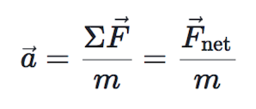


Code
Euler’s Method to find new position and new velocity at each point
Bisection Method
Code Validation
Acceleration (x and y axis)
dt = 0.001s

Slide 5
Results
Goal: The optimal launch angle
Frisbee trajectory using the optimal angle.
Best angle: 10.29 degrees
Max distance: 19.19 m
Notes:
You can use this type of slide for text, images, shapes and tables to help add information in a different way. Duplicate this slide to add additional images of important location in your visit.

Slide 6
Results
Frisbee trajectory using a smaller angle than the optimal angle.
Goal: The optimal launch angle
Angle: 8.00 degrees
Max distance: 18.68 m
Frisbee trajectory using a bigger
angle than the optimal angle.
Frisbee trajectory using the optimal angle.
Best angle: 10.29 degrees
Max distance: 19.19 m
Angle: 12.00 degrees
Max distance: 19.07 m
Notes:
You can use this type of slide for text, images, shapes and tables to help add information in a different way. Duplicate this slide to add additional images of important location in your visit.

Slide 7
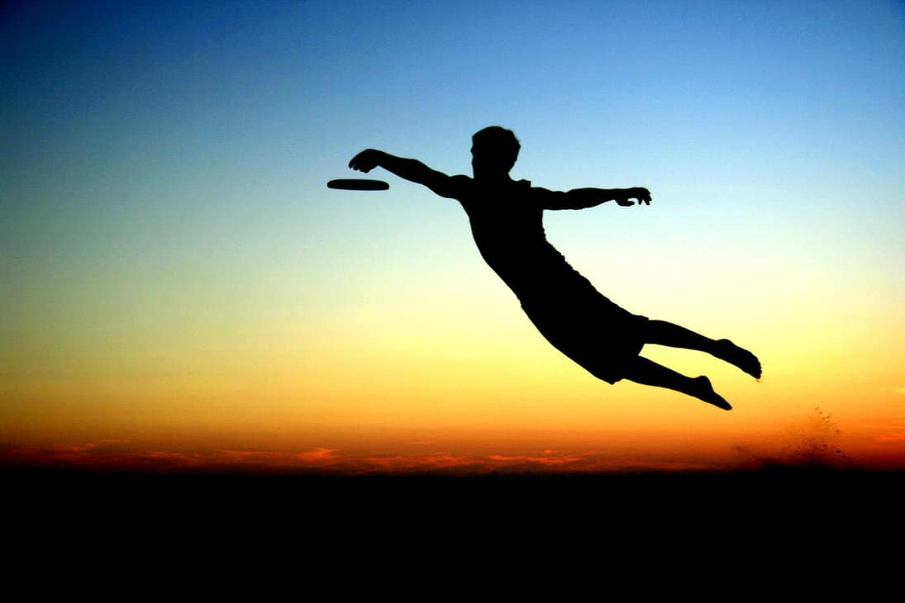
Thank you!

